Slide 1






Knowledge Graph Completion Part 3: Identity Link Validation
Fatiha Saïs ⁽¹⁾
Nathalie Pernelle⁽¹⁾
Danai Symeonidou⁽²⁾
and collaboration with J. Raad⁽¹⁾, W. Beek⁽³⁾
⁽¹⁾ Lri, Paris Sud University, CNRS, Paris Saclay university
⁽²⁾ INRA, GaMMA team
⁽³⁾ Dept. of Computer Science, VU Univ. Amsterdam, NL

Slide 2

Identity Problem
Today, the classical definition of identity has become the canonical one on the Semantic Web (through owl:sameAs predicate).
There are some problems with it,
Identity does not hold across modal contexts
Allow Lois Lane to believe that Superman saved her without requiring her to believe that Clark Kent saved her.
* https://pridiyawulan.blogspot.fr/2015/01/clark-kent-atau-superman-pilih-yang-mana.html
Notes:
https://pridiyawulan.blogspot.fr/2015/01/clark-kent-atau-superman-pilih-yang-mana.html
wouterbeek.github.io

Slide 3
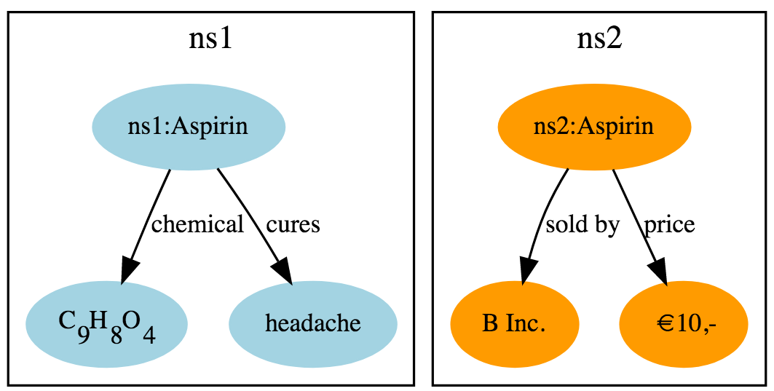
Identity Problem
Today, the classical definition of identity has become the canonical one on the Semantic Web (through owl:sameAs predicate).
There are some problems with it,
Identity does not hold across modal contexts
Identity is context-dependent [Geach, 1967]
allowing two medicines to be considered the same in terms of their chemical substance, but different in terms of their price (e.g., because they are produced by different companies).
*
*
wouterbeek.github.io
Notes:
https://pridiyawulan.blogspot.fr/2015/01/clark-kent-atau-superman-pilih-yang-mana.html
wouterbeek.github.io

Slide 4

Identity Problem
Today, the classical definition of identity has become the canonical one on the Semantic Web (through owl:sameAs predicate).
There are some problems with it,
Identity does not hold across modal contexts
Identity is context-dependent [Geach, 1967]
Identity over time poses problems
since a car may be considered the same car, even though some (or even all) of its original components have been replaced by new ones.
Car 1
Car 2
= ?
Notes:
https://pridiyawulan.blogspot.fr/2015/01/clark-kent-atau-superman-pilih-yang-mana.html
wouterbeek.github.io

Slide 5
owl:sameAs predicate
owl:sameAs, indicates that two different descriptions refer to the same entity
a strict semantics,
Reflexive,
Symmetric,
Transitive and
Fulfils property sharing:
∀X∀Y owl:sameAs(X, Y)∧ p(X, Z) ⇒ p(Y, Z)
Notes:
From Leibniz [Forrest, 2008] identity relation respects:
Indiscernibility of Identicals
Identity of Indiscernibles

Slide 6

Identity problem
In [Jaffri et al., 2008], the authors discuss how erroneous use of owl:sameAs in the interlinking of the DBpedia and DBLP datasets has resulted in publications becoming incorrectly assigned to different authors.
[Halpin et al. 2010] showed that 37% of owl:sameAs links randomly selected among 250 identity links between books were incorrect.
Automatic data linking tools do not guarantee 100% precision, because of:
Errors, missing information, data freshness, etc.
owl:sameAs
b₁
b₂
owl:sameAs
b₄
b₃
owl:sameAs
b₁
b₅
owl:sameAs
b₅
b₆

Slide 7
Identity Problem: some solutions
Detection of erroneous identity links
Use of alternate links
Detection of contextual identity links
Notes:
https://pridiyawulan.blogspot.fr/2015/01/clark-kent-atau-superman-pilih-yang-mana.html
wouterbeek.github.io

Slide 8
1. Detection of erroneous identity links
Which kind of information to use for detecting erroneous Identity links?
b1
owl:sameAs(b1, b2)?
b2

Slide 9
1. Detection of erroneous identity links
Content
Which kind of information to use for detecting erroneous Identity links?
A Semantic Web Primer
A Semantic Web Primer
208
nbPages
titre
titre
nbPages
288
2007
pubYear
b1
owl:sameAs(b1, b2)?
b2
pubYear
2007
author
author
author
author
a11
a22
a21
a12
aName
aName
aName
aName
Paul Grauth
Grigoris Antoniou
P. Grauth
G. Antoniou

Slide 10
1. Detection of erroneous identity links
Content
Identity Network
Which kind of information to use for detecting erroneous Identity links?
A Semantic Web Primer
A Semantic Web Primer
208
nbPages
titre
titre
nbPages
288
owl:sameAs(b1, b2)?
pubYear
2007
pubYear
b1
owl:sameAs(b1, b2)?
b2
2007
b1
b2
author
author
author
author
a11
a22
a21
a12
aName
owl:sameAs(b1, b6)?
aName
owl:sameAs(b1, b6)?
aName
aName
owl:sameAs(b2, b10)?
Paul Grauth
Grigoris Antoniou
P. Grauth
G. Antoniou
b3
b3
b8
b8
b6
b6
b5
b5
b9
b9
b10
b10
b4
b7
b4
b7
b12
b11
b12
b11

Slide 11
1. Detection of erroneous identity links
Content
Identity Network
Which kind of information to use for detecting erroneous Identity links?
UNA
A Semantic Web Primer
A Semantic Web Primer
Trustworthiness
208
nbPages
titre
titre
nbPages
288
owl:sameAs(b1, b2)?
pubYear
2007
pubYear
b1
owl:sameAs(b1, b2)?
b2
2007
b1
b2
author
author
author
author
a11
a22
a21
a12
aName
owl:sameAs(b1, b6)?
aName
owl:sameAs(b1, b6)?
aName
aName
owl:sameAs(b2, b10)?
Paul Grauth
Grigoris Antoniou
P. Grauth
G. Antoniou
b3
b3
b8
b8
b6
b6
b5
b5
b9
b9
b10
b10
b4
b7
b4
b7
b12
b11
b12
UNA(S1)
UNA(S2)
UNA(S3)
b11
>
>

Slide 12
1. Detection of erroneous identity links
Content
Identity Network
Which kind of information to use for detecting erroneous Identity links?
UNA
A Semantic Web Primer
A Semantic Web Primer
Trustworthiness
208
nbPages
titre
titre
nbPages
288
owl:sameAs(b1, b2)?
2007
pubYear
owl:sameAs(b1, b2)?
b2
pubYear
2007
b1
b2
b1
Ontology Axioms:
Func(nbPages)
LC(author)
Func(title)
Disj(Science-fiction, Memoir),
…
author
author
author
author
a11
a22
a21
a12
aName
aName
owl:sameAs(b1, b6)?
aName
aName
owl:sameAs(b2, b10)?
Paul Grauth
Grigoris Antoniou
P. Grauth
G. Antoniou
Func(nbPages)
LFunc(author)
b3
b8
b6
b5
b9
b10
b7
b4
UNA(S1)
UNA(S2)
UNA(S3)
b11
b12
>
>

Slide 13
1. Detection of erroneous identity links
T
Inconsistency-based
Network-Based
Content-Based
Ontology
axioms
Community
Detection
Network
Metrics
UNA
Trustworthiness
Cudré-Mauroux et al. 2009
Papaleo et al. 2014
Paulheim
2014
Raad et al. 2018
Guéret et al. 2016
[ de Melo, 2013 ]
[ Valdestilhas et al., 2017 ]
Notes:
https://pridiyawulan.blogspot.fr/2015/01/clark-kent-atau-superman-pilih-yang-mana.html
wouterbeek.github.io

Slide 14
Inconsistency-based

Slide 15
1. Detection of erroneous identity links
T
Inconsistency-based
Network-Based
Content-Based
Ontology
axioms
Community
Detection
Network
Metrics
UNA
Trustworthiness
Cudré-Mauroux et al. 2009
Papaleo et al. 2014
Paulheim
2014
Raad et al. 2018
Guéret et al. 2016
[ de Melo, 2013 ]
[ Valdestilhas et al., 2017 ]
Notes:
https://pridiyawulan.blogspot.fr/2015/01/clark-kent-atau-superman-pilih-yang-mana.html
wouterbeek.github.io

Slide 16
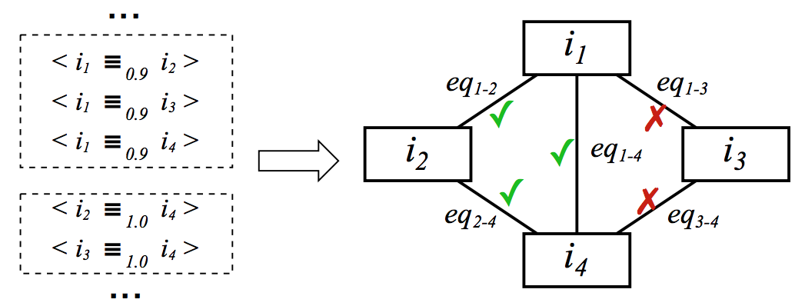
SOURCE TRUSTWORTHINESS
Cudré-Mauroux et al. 2009
Principle: owl:sameAs and owl:differentFrom links published by trusted sources are more likely to be correct. Every pair of URIs coming from the same source are necessary different.
idMech: a probabilistic and decentralized framework for entity disambiguation.
Trusted
Source S1
Unknown
Source S2

Slide 17
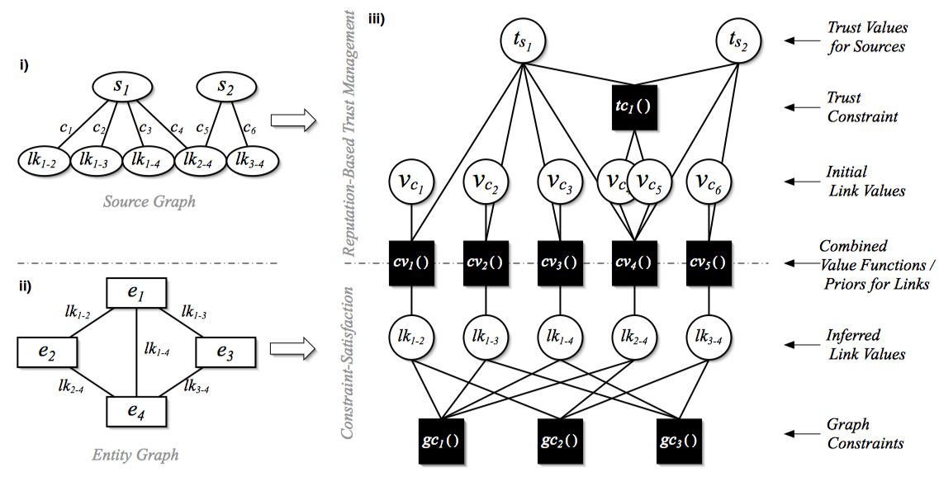
SOURCE TRUSTWORTHINESS
Probabilistic Disambiguation
Cudré-Mauroux et al. 2009
Conflicting links detection: a graph-based constraint satisfaction problem that exploits owl:sameAs symmetry and transitivity.
Conflicting links resolution: use of iteratively reﬁned trustworthiness of the sources declaring the statements.
Notes:
The graph constraint function gc() relating links lk12 , . . . , lkn
P(gc=1 | lk12 , . . . , lkn) = 0 (if exactly one noneq link in the cycle)
= 1 oltherwise.
- We put as much gc as cycles in the graph.
- Link variables lk can take values eq or noneq depending on whether they represent equivalence or non-equivalence relations. Obviously, P(lk = eq)+P(lk = noneq) = 1 for our link variables.
t() capturing the initial degree of trust for each source.
when conﬂicting values are simultaneously considered by trusted sources, the conditional probability function tc() is used to forbid impossible value assignements.

Slide 18

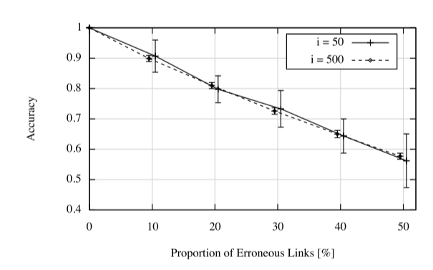
SOURCE TRUSTWORTHINESS
Evaluation on Synthetic Data
Cudré-Mauroux et al. 2009
Dataset
Networks of 50 and 500 entities, 150/3000 links, and a varying fraction of erroneous links (from 0 to 50%)
Results
When considering relatively dense networks, cycles up to size 4 and a varying fraction of erroneous links from 0 to 50%:
The more erroneous links, the lower the accuracy is.
The size of the graph has no impact on the accuracy of the inference.
Notes:
Shows high accuracy even when 90% of the sources are actually spammers feeding erroneous information.
Scalability evaluation: a maximum scale involving 8,000 entities and 24,000 links, over 400 machines, focusing solely on network trafﬁc and message exchange as opposed to time.

Slide 19
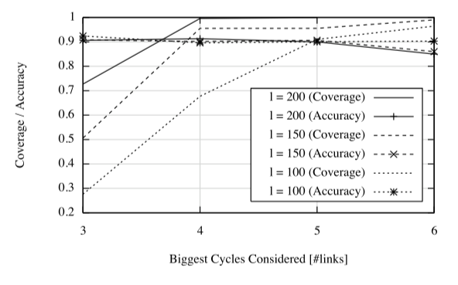
SOURCE TRUSTWORTHINESS
Evaluation on Synthetic Data
Cudré-Mauroux et al. 2009
Dataset
Networks of 50 entities, 100/150/200 links, 10% erroneous links, and varying cycle length (from 3 to 6).
Results
Accuracy/coverage for the graph-based constraint-satisfaction:
Accuracy does not depend on the length of the cycles.
Longer cycles is beneﬁcial for the coverage, especially for sparse networks
Scalability evaluation: an experiment involving 8,000 entities and 24,000 links.
Notes:
Shows high accuracy even when 90% of the sources are actually spammers feeding erroneous information.
Scalability evaluation: a maximum scale involving 8,000 entities and 24,000 links, over 400 machines, focusing solely on network trafﬁc and message exchange as opposed to time.

Slide 20
1. Detection of erroneous identity links
T
Inconsistency-based
Network-Based
Content-Based
Ontology
axioms
Community
Detection
Network
Metrics
UNA
Trustworthiness
Cudré-Mauroux et al. 2009
Papaleo et al. 2014
Paulheim
2014
Raad et al. 2018
Guéret et al. 2016
[ de Melo, 2013 ]
[ Valdestilhas et al., 2017 ]
Notes:
https://pridiyawulan.blogspot.fr/2015/01/clark-kent-atau-superman-pilih-yang-mana.html
wouterbeek.github.io

Slide 21
UNIque Name Assumption violation
[de Melo 2013, Valdestilhas et al., 2017 ]
Principle
Detecting erroneous owl:sameAs links based on Unique Name Assumption (UNA).
The violation of the UNA is indicative of erroneous identity links.
UNA allows to state that
Every pair of URIs coming from the same source are necessary different.
b3
b6
S1
b1
b7
b4
S2
b5
S3
b8
b9

Slide 22
UNIque Name Assumption violation
[de Melo 2013, Valdestilhas et al., 2017 ]
Principle: detecting erroneous owl:sameAs links based on Unique Name Assumption. These approaches hypothesize that individual datasets preserve the Unique Name Assumption (UNA), and that violations of the UNA are indicative of erroneous identity links.
UNA allows to state that:
Every pair of URIs coming from the same source are necessary different.
b3
b6
S1
b1
b7
b4
S2
b5
S3
b8
b9

Slide 23
UNIque Name Assumption violation
[de Melo 2013, Valdestilhas et al., 2017 ]
Principle: detecting erroneous owl:sameAs links based on Unique Name Assumption. These approaches hypothesize that individual datasets preserve the Unique Name Assumption (UNA), and that violations of the UNA are indicative of erroneous identity links.
UNA allows to state that:
Every pair of URIs coming from the same source are necessary different.
Each URI of a source S1 cannot be identical to more than one URI of a source S2.
b3
b6
S1
b1
b7
b4
S2
?
?
b5
S3
b8
b9

Slide 24
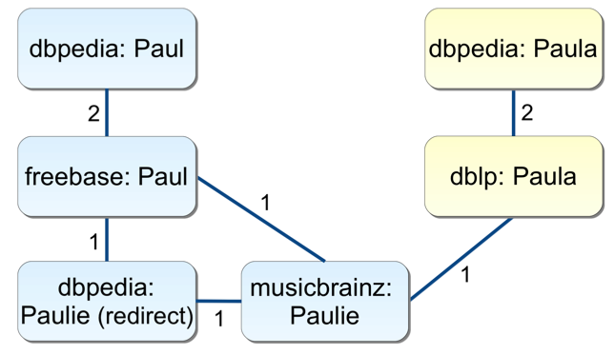
UNA Violation
[de Melo 2013]
Creates undirected labeled graphs from the existing owl:sameAs links.
Considers a set of distinctness constraints to consider exceptions.
D_{i}({dbpedia:Paul, dbpedia:Paulie(redirect)},
{dbpedia:Paula})
Notes:
Computing an optimal cut is NP-Hard.

Slide 25
UNA violatioN
[de Melo 2013]
Creates undirected labeled graphs from the existing owl:sameAs links.
Considers a set of distinctness constraints to consider exceptions.
Considers the problem of computing the minimum cut (NP-Hard Problem)
Uses a linear program relaxation algorithm, that aims at deleting the minimal number of edges to ensure the UNA.
D_{i}({dbpedia:Paul, dbpedia:Paulie(redirect)},
{dbpedia:Paula})
Notes:
Computing an optimal cut is NP-Hard.
Mixed integer linear programming is NP-hard.
If we relax (4) to d e ∈ [0, 1] and not e ∈ {0, 1} , we obtain a linear program that can be solved in polynomial time.
He combined different results to efﬁciently obtain a set of d_e ∈ {0, 1} that satisfy logarithmic approximation guarantees with respect to the optimal solution.

Slide 26
UNA violation
Evaluation LOD Data
[de Melo 2013]
Datasets
 | #URI | Relevant Predicates
 |  | #sameAs | #skos:closeMatch | #skos:exactMatch | #:differentFrom
BTC2011 | ~4M | ~3.5M | 125,313 | 22,398 | 619
sameas.org 2011 | ~31M | 22.4M
Notes:
Computing an optimal cut is NP-Hard.

Slide 27
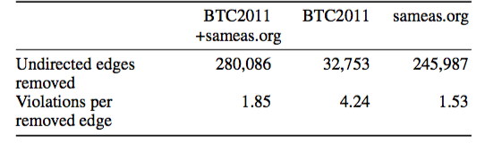
UNA violation
Evaluation LOD Data
[de Melo 2013]
Datasets
Results
½ million of UNA violation
Several hundred thousand sameAs edges are removed automatically.
# edges removed < # constraint violations
 | #URI | Relevant Predicates
 |  | #sameAs | #skos:closeMatch | #skos:exactMatch | #:differentFrom
BTC2011 | ~4M | ~3.5M | 125,313 | 22,398 | 619
sameas.org 2011 | ~31M | 22.4M
Notes:
Computing an optimal cut is NP-Hard.

Slide 28
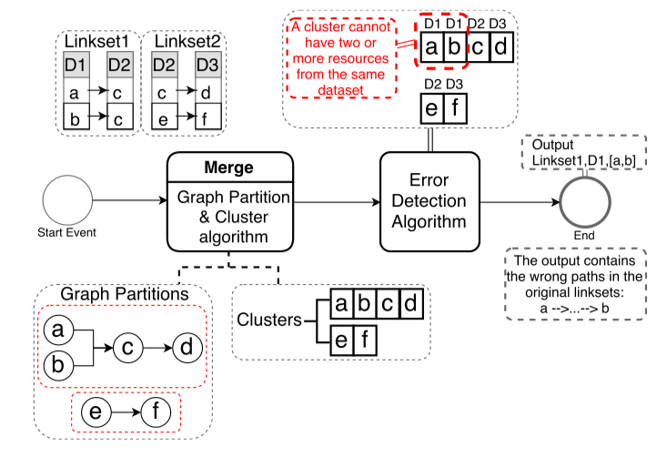
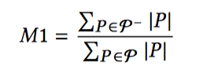
UNA violation
[Valdestilhas et al., 2017 ]
Efficient generation of equivalence classes based on Union Find algorithm
Erroneous links: detection of resources sharing the same equivalence class and the same dataset.
Rate of consistent resources inside an equivalence class
P contains only resources belonging to the same dataset.
P⁻ is the set of consistent resources
Notes:
A → C
B → C

Slide 29
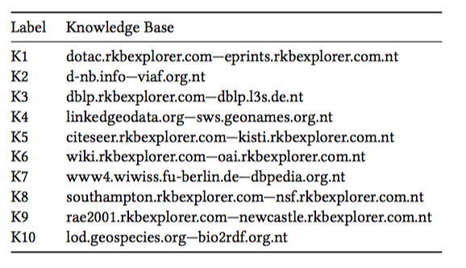
UNA violation
[Valdestilhas et al., 2017 ]
Datasets
LinkLion repository ~19.6M links
µ = ½ (|C| (|C| -1)), C is the set of inconsistent resources
K1: the knowledge base with more errors (11.5 %)
K10: the knowledge base with fewer errors (0.06 %)
Data linking algorithms (LIMES, SILK and DBpedia Extraction Framework) have a better consistency index than repositories such as sameas.org (13%).
Notes:
µ = ½ (|C| (|C| -1)), C is the set of inconsistent resources (thanks to M1)

Slide 30
1. Detection of erroneous identity links
T
Inconsistency-based
Network-Based
Content-Based
Ontology
axioms
Community
Detection
Network
Metrics
UNA
Trustworthiness
Cudré-Mauroux et al. 2009
Papaleo et al. 2014
Paulheim
2014
Raad et al. 2018
Guéret et al. 2016
[ de Melo, 2013 ]
[ Valdestilhas et al., 2017 ]
Notes:
https://pridiyawulan.blogspot.fr/2015/01/clark-kent-atau-superman-pilih-yang-mana.html
wouterbeek.github.io

Slide 31
Ontology axiom violation
[Papaleo et al., 2014]
[Hogan et al. 2012]
Principle: use of ontology axioms (functionality, local completeness, asymmetry, etc. ) to detect inconsistencies or error candidates in the linked resources descriptions.
nbPages is a Functional Property
A Semantic Web Primer
A Semantic Web Primer
208
nbPages
titre
titre
nbPages
288
2007
pubYear
b1
owl:sameAs(b1, b2)?
b2
pubYear
2007
author
author
author
author
a11
a22
a21
a12
aName
aName
aName
aName
Paul Grauth
Grigoris Antoniou
P. Grauth
G. Antoniou

Slide 32
Ontology axiom violation
[Papaleo et al., 2014]
A logical ontology-based method to detect invalid sameAs statements
Builds a contextual graph «around» each one of the two resources involved in the sameAs by exploiting ontology axioms on:
functionality and inverse functionality of properties and
local completeness of some properties, e.g., the author list of a book.
Analyses the descriptions provided in these contextual graphs to eventually detect inconsistencies or high dissimilarities.

Slide 33
Ontology axiom violation
[Papaleo et al., 2014]
Apply Unit Resolution on {F∪R}.
[F set of facts, R set of rules]
F is the set of RDF facts enriched by a set of ¬synVals facts in the form ¬synVals(w₁, w₂) w₁ and w₂, being literals and different.
EXAMPLES:
- notSynVals(‘231’,’100’) for a functional property numOfPages
-notSynVals(‘New York’, ‘Paris’) for a functional property cityName
… knowledge from expert or extracted.
of 20
33

Slide 34
Ontology axiom violation
[Papaleo et al., 2014]
Apply Unit Resolution on {F∪R}.
[F set of facts, R set of rules]
R the set of rules
(inverse) functional properties
sameAs(x,y) ∧numOfPages(x,w₁) ∧ numOfPages(y,w₂) → SynVals(w₁,w₂)
local complete properties
sameAs(x,y) ∧ hasAuthor(x,w₁)
→ hasAuthor(y,w₁)
of 20
34
Notes:
Semantics of equality.
Equality relation owl:sameAs as being reflexive, symmetric, and transitive,
and it axiomatizes the standard replacement properties of equality for it.
Table 4. The Semantics of Equality
eq-ref T(?s, ?p, ?o) T(?s, owl:sameAs, ?s) T(?p, owl:sameAs, ?p) T(?o, owl:sameAs, ?o)
eq-sym T(?x, owl:sameAs, ?y) T(?y, owl:sameAs, ?x)
eq-trans T(?x, owl:sameAs, ?y)
T(?y, owl:sameAs, ?z) T(?x, owl:sameAs, ?z)
eq-rep-s T(?s, owl:sameAs, ?s') T(?s', ?p, ?o)
T(?s, ?p, ?o)
eq-rep-p T(?p, owl:sameAs, ?p') T(?s, ?p', ?o) T(?s, ?p, ?o)
eq-rep-o T(?o, owl:sameAs, ?o') T(?s, ?p, ?o') T(?s, ?p, ?o)

Slide 35
Ontology axiom violation
[Papaleo et al. 2014]
OAEI 2010 dataset on Restaurants
Use of the output of different linking tools [1], [2] and [3].
[1] Sais et al.: LN2R a knowledge based reference reconciliation system: OAEI2010 results. (2010)
[2] Symeonidou et al.: SAKey: Scalable Almost Key Discovery in RDF Data. (2014)
[3] Yves et al.: Ontology matching with semantic verification. (2009)
has_category
restaurant2
‘bel air’
‘Californian’
has_address
city
name
phone_number
street
‘818/788-3536’
‘cafe bizou’
‘701 stone canyon rd.’
2-degree contextual graph
phone_number, hasAddress & city
(possible synvals computation)
of 20
35
Notes:
In [20] the sameAs statements are computed according to similarity measures over specific property descriptions, as in [26] where similarity between entities is iteratively calculated by analyzing specific features. In [24], instead sameAs statements are computed on the basis of a novel algorithm for key discovery.
We tested the approach on sameAs statements provided by linking tools that have been applied on
Ontology Alignment Evaluation Initiative (OAEI) datasets, showing that our research direction is promising.

Slide 36
Ontology axiom violation
[Papaleo et al. 2014]
LM | LM Precision | TC | RG | TN | TP | FN | FP | Accuracy | Recall | IA precision | LM+IA precision
2 | 95.55% | 90 | 4 | 81 | 3 | 1 | 5 | 93,34% | 75% | 37% | 98.85%
1 | 69.71% | 142 | 43 | 94 | 38 | 5 | 5 | 92.9% | 88.4% | 88.4% | 95.19%
3 | 90.17% | 112 | 11 | 86 | 11 | 0 | 16 | 86.60% | 100% | 42.30% | 100%
Improvement in precision
of 20
36
Notes:
In conclusion, our results showed that, when our validation tool is applied after one of the linking tool, the precision of each tool can be improved, namely for [24] we pass from a precision of 95.55% to 98.85%, for [20] from a precision of 69.71% to 95.19% and finally for [26] from a precision of 90.17% to 100%.

Slide 37
Ontology axiom violation
[Papaleo et al. 2014]
Because we cannot find inconsistencies wrt the selected properties
LM | LM Precision | TC | RG | TN | TP | FN | FP | Accuracy | Recall | IA precision | LM+IA precision
2 | 95.55% | 90 | 4 | 81 | 3 | 1 | 5 | 93,34% | 75% | 37% | 98.85%
1 | 69.71% | 142 | 43 | 94 | 38 | 5 | 5 | 92.9% | 88.4% | 88.4% | 95.19%
3 | 90.17% | 112 | 11 | 86 | 11 | 0 | 16 | 86.60% | 100% | 42.30% | 100%
Because there are errors in the data, synvals were not accurate or some functional properties are not functional
of 20
37
Notes:
In conclusion, our results showed that, when our validation tool is applied after one of the linking tool, the precision of each tool can be improved, namely for [24] we pass from a precision of 95.55% to 98.85%, for [20] from a precision of 69.71% to 95.19% and finally for [26] from a precision of 90.17% to 100%.

Slide 38
1. Detection of erroneous identity links
T
Inconsistency-based
Network-Based
Content-Based
Ontology
axioms
Community
Detection
Network
Metrics
UNA
Trustworthiness
Cudré-Mauroux et al. 2009
Papaleo et al. 2014
Paulheim
2014
Raad et al. 2018
Guéret et al. 2016
[ de Melo, 2013 ]
[ Valdestilhas et al., 2017 ]
Notes:
https://pridiyawulan.blogspot.fr/2015/01/clark-kent-atau-superman-pilih-yang-mana.html
wouterbeek.github.io

Slide 39
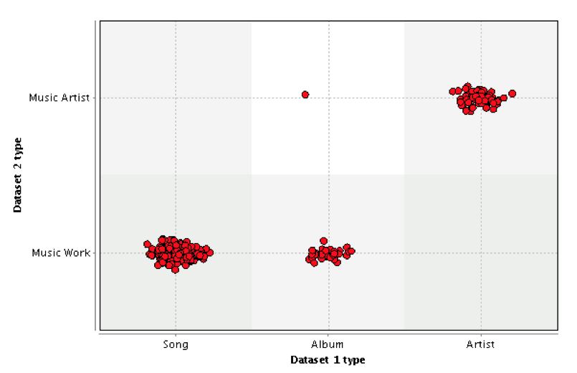
Content based
[Paulheim, 2014]
Principle: links follow certain patterns, links that violate those patterns are erroneous.
A multi-dimensional and scalable outlier detection approach for finding erroneous identity links.
Projection of links into Vector Space: each link is a point in an n-dimensional vector space

Slide 40
Content based
[Paulheim, 2014]
Principle: links follow certain patterns, links that violate those patterns are erroneous.
A multi-dimensional and scalable outlier detection approach for finding erroneous identity links.
Projection of links into Vector Space: each link is a point in an n-dimensional vector space
Outliers are found in sparse areas

Slide 41
Content based
[Paulheim, 2014]
Binary features: resource types and ingoing/outgoing properties
e.g. LHS_foaf:based_near and RHS_foaf:based_near are distinct features.
Different strategies of creating vectors: direct types only, all ingoing and outgoing properties, or a combination
Several outlier detection methods were tested: LOF, CBLOF, LOP, 1-class SVM etc.
Each method assign a score to each data point indicating the likeliness of being an outlier ➔ incorrect link.
Notes:
LOF: Local Outlier factor
LOP: Local Outilier probabilities.

Slide 42
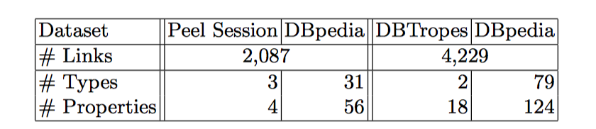
Content based
[Paulheim, 2014]
D1
D2
Dataset
Gold Standard: 100 randomly sampled links from D1 and D2
Use of RapidMiner with anomaly detection and LOD extensions (6 methods)

Slide 43
Content based
[Paulheim, 2014]
D1
D2
Dataset
Gold Standard: 100 randomly sampled links from D1 and D2
Use of RapidMiner with anomaly detection and LOD extensions (6 methods)
Best performance on D1:
CBLOF (F1= 0.537),1-class SVM (AUC = 0.857)
Best performance on D2:
LOF (F1= 0.5, AUC = 0.619)

Slide 44
Content based
[Paulheim, 2014]
D1
D2
Dataset
Gold Standard: 100 randomly sampled links from D1 and D2
Use of RapidMiner with anomaly detection and LOD extensions (6 methods)
Best performance on D1:
CBLOF (F1= 0.537),1-class SVM (AUC = 0.857)
Best performance on D2:
LOF (F1= 0.5, AUC = 0.619)
Examples of typical source of errors for D1:
Linking of songs to albums with the same name.
Linking of diﬀerent persons of the same name,
e.g., a blues musician named Jimmy Carter to the U.S. president.

Slide 45
Network based
[Guéret et al., 2012]
[Raad et al., 2018, UR]
Principle
The quality of a link can be determined based on how connected a node is within the network in which it appears.
Use of network metrics and structures can help to detect erroneous links?

Slide 46
Network based
Node in-degree and out-degree
Clustering coefficient:
C(b16)=1; C(b20)=2/3; C(b23)=4/7
b3
b17
b6
b16
b4
b19
b7
b18
b1
b2
b5
b20
b21
b8
b9
b11
b10
b24
b22
b23
b13
b12
b26
b15
b25
b14
b28
b27

Slide 47
Network based
Centrality
b3
b17
b6
b16
b4
b18
b19
b7
b1
b2
b5
b20
b21
b8
b9
b11
b10
b24
b22
b23
b13
b12
b26
b15
b25
b14
b28
b27

Slide 48
Network based
Modularity and communities
b3
b17
b6
b16
b4
b18
b19
b7
b1
b2
b5
b20
b21
b8
b9
b11
b10
b24
b22
b23
b13
b12
b26
b15
b25
b14
b28
b27

Slide 49
Network based
[Guéret et al., 2012]
Use of network metrics can help to detect erroneous links?
Changes in quality of the Web of Data with the introduction of new links between datasets.
It is based on the use of
three classic network metrics: clustering coefficient, centrality and degree
two Linked Data-specific ones: owl:sameAs chains, and description richness
Notes:
Assessing Linked Data Mappings Using Network Measures
Christophe Gu ́eret1, Paul Groth1, Claus Stadler2, and Jens Lehmann2
- Les graphes contexts qu’ils considère sont de profounder 2 uniquement.
studies of the Web of Data as a network that show that fragmentation of the SameAs network is common and thus may be a sign of low quality [12].
The interest of the use of network metrics : We consider the following to be broad quality goals that should be reached by the creation of links: 1. modifications should bring the topology of the network closer to that of a power law network to make the network more robust against random failure; 2. modifications should lower the differences between the centrality of the hubs in the network to make the network more robust against targeted failure of these critical nodes; 3. modifications should increase the clustering within topical groups of resources and also lower the average path length between groups (i.e. foster a small world network).
----------
The metrics :
------------
1- The degree of a node is given by its number of incoming and outgoing edges.
2- The local clustering coefficient of a node ni is given by the ratio between the number of links among its neighbours and the number of possible
links.
Comment: Ideal. The highest average clustering coefficient a network can have is 1, mean- ing that every node is connected to every other node (the network is said to be “complete”). Although this is a result the Web of Data should not aim at, as most links would then be meaningless, an increase of the clustering coeffi- cient is a sign of cohesiveness among local clusters.
3- The centrality of a node vi is given by the number of connections it takes part in. This value is obtained by the product between the number of nodes reaching vi through its incoming neighbours, and the number of nodes reachable through the outgoing neighbours.
4- SameAs Chains : The metric counts the number of sameAs chains that are not closed.
Comment: The very common owl:sameAs property can be improperly asserted. One way to confirm a given sameAs relation is correct is to find closed chains of sameAs re- lations between the linking resource and the resource linked. This metric detects whether there are open sameAs chains in the network.
5- Descriptive Richness through SameAs
This metric measures how much to the description of a resource is added through the use of sameAs edges. If a sameAs edge is introduced, we can measure whether or not that edge adds to the description.
The measure counts the number of new edges brought to a resource through the sameAs relation(s).
Comment: A resource’s outgoing sameAs relations ideally link to resources that have a complementary description to the original one. Therefore, the richer the resulting description, the lower the distance to our ideal.

Slide 50
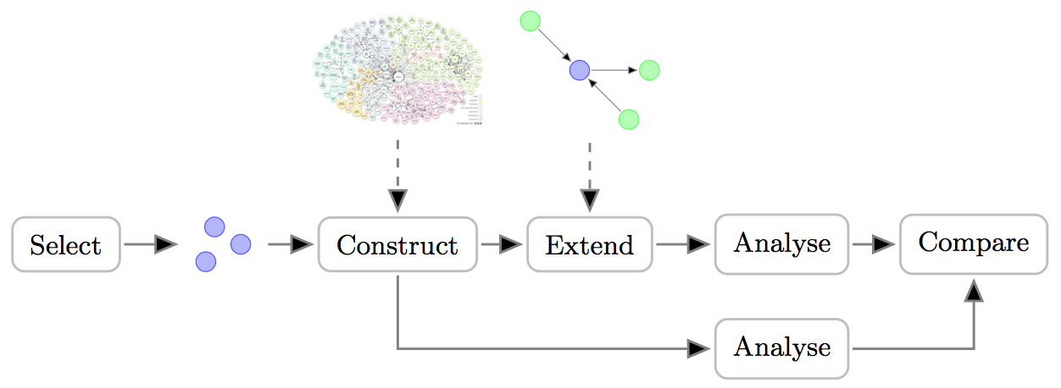
Network based
[Guéret et al., 2012]
-- Link-QA Workflow
The approach selects a set of resources and constructs a local network for each resource by querying the Web of Data.
After analysis, i.e., measuring the different metrics, each local network is extended by adding new edges and analyzed again.
The result coming from both analyses are compared to ideal distribution for the different metrics.
Notes:
Assessing Linked Data Mappings Using Network Measures
Christophe Gu ́eret1, Paul Groth1, Claus Stadler2, and Jens Lehmann2
- Les graphes contexts qu’ils considère sont de profounder 2 uniquement.
studies of the Web of Data as a network that show that fragmentation of the SameAs network is common and thus may be a sign of low quality [12].
The interest of the use of network metrics : We consider the following to be broad quality goals that should be reached by the creation of links: 1. modifications should bring the topology of the network closer to that of a power law network to make the network more robust against random failure; 2. modifications should lower the differences between the centrality of the hubs in the network to make the network more robust against targeted failure of these critical nodes; 3. modifications should increase the clustering within topical groups of resources and also lower the average path length between groups (i.e. foster a small world network).
----------
The metrics :
------------
1- The degree of a node is given by its number of incoming and outgoing edges.
2- The local clustering coefficient of a node ni is given by the ratio between the number of links among its neighbours and the number of possible
links.
Comment: Ideal. The highest average clustering coefficient a network can have is 1, mean- ing that every node is connected to every other node (the network is said to be “complete”). Although this is a result the Web of Data should not aim at, as most links would then be meaningless, an increase of the clustering coeffi- cient is a sign of cohesiveness among local clusters.
3- The centrality of a node vi is given by the number of connections it takes part in. This value is obtained by the product between the number of nodes reaching vi through its incoming neighbours, and the number of nodes reachable through the outgoing neighbours.
4- SameAs Chains : The metric counts the number of sameAs chains that are not closed.
Comment: The very common owl:sameAs property can be improperly asserted. One way to confirm a given sameAs relation is correct is to find closed chains of sameAs re- lations between the linking resource and the resource linked. This metric detects whether there are open sameAs chains in the network.
5- Descriptive Richness through SameAs
This metric measures how much to the description of a resource is added through the use of sameAs edges. If a sameAs edge is introduced, we can measure whether or not that edge adds to the description.
The measure counts the number of new edges brought to a resource through the sameAs relation(s).
Comment: A resource’s outgoing sameAs relations ideally link to resources that have a complementary description to the original one. Therefore, the richer the resulting description, the lower the distance to our ideal.

Slide 51
Network based
[Guéret et al., 2012]
Dataset
The European project LOD Around the Clock (LATC) aims to enable the use of the Linked Open Data cloud for research and business purposes.
LATC created a set of linking specifications (link specs) for Silk engine
6 link sets are selected containing more than 50 correct and incorrect links
e.g., linkedct-pubmedDisease, geonames-linkedGeodataMountain, …
Samples taken from the generated links are manually checked
Two reference sets containing all the positive (correct, good) and negative (incorrect, bad) links of the sample.
Notes:
Assessing Linked Data Mappings Using Network Measures
Christophe Gu ́eret1, Paul Groth1, Claus Stadler2, and Jens Lehmann2
- Les graphes contexts qu’ils considère sont de profounder 2 uniquement.
studies of the Web of Data as a network that show that fragmentation of the SameAs network is common and thus may be a sign of low quality [12].
The interest of the use of network metrics : We consider the following to be broad quality goals that should be reached by the creation of links: 1. modifications should bring the topology of the network closer to that of a power law network to make the network more robust against random failure; 2. modifications should lower the differences between the centrality of the hubs in the network to make the network more robust against targeted failure of these critical nodes; 3. modifications should increase the clustering within topical groups of resources and also lower the average path length between groups (i.e. foster a small world network).
----------
The metrics :
------------
1- The degree of a node is given by its number of incoming and outgoing edges.
2- The local clustering coefficient of a node ni is given by the ratio between the number of links among its neighbours and the number of possible
links.
Comment: Ideal. The highest average clustering coefficient a network can have is 1, mean- ing that every node is connected to every other node (the network is said to be “complete”). Although this is a result the Web of Data should not aim at, as most links would then be meaningless, an increase of the clustering coeffi- cient is a sign of cohesiveness among local clusters.
3- The centrality of a node vi is given by the number of connections it takes part in. This value is obtained by the product between the number of nodes reaching vi through its incoming neighbours, and the number of nodes reachable through the outgoing neighbours.
4- SameAs Chains : The metric counts the number of sameAs chains that are not closed.
Comment: The very common owl:sameAs property can be improperly asserted. One way to confirm a given sameAs relation is correct is to find closed chains of sameAs re- lations between the linking resource and the resource linked. This metric detects whether there are open sameAs chains in the network.
5- Descriptive Richness through SameAs
This metric measures how much to the description of a resource is added through the use of sameAs edges. If a sameAs edge is introduced, we can measure whether or not that edge adds to the description.
The measure counts the number of new edges brought to a resource through the sameAs relation(s).
Comment: A resource’s outgoing sameAs relations ideally link to resources that have a complementary description to the original one. Therefore, the richer the resulting description, the lower the distance to our ideal.

Slide 52
Network based
[Guéret et al., 2012]
Evaluation questions
Do positive linksets decrease the distance to a metric’s defined ideal, whereas negative ones increase it?
If that is the case, it would allow us to distinguish between link sets having high and low ratios of bad links.
Is there a correlation between outliers and bad links?
If so, resources that rank farthest from the ideal distribution of a metric would relate to incorrect links from/to them.
Notes:
Assessing Linked Data Mappings Using Network Measures
Christophe Gu ́eret1, Paul Groth1, Claus Stadler2, and Jens Lehmann2
- Les graphes contexts qu’ils considère sont de profounder 2 uniquement.
studies of the Web of Data as a network that show that fragmentation of the SameAs network is common and thus may be a sign of low quality [12].
The interest of the use of network metrics : We consider the following to be broad quality goals that should be reached by the creation of links: 1. modifications should bring the topology of the network closer to that of a power law network to make the network more robust against random failure; 2. modifications should lower the differences between the centrality of the hubs in the network to make the network more robust against targeted failure of these critical nodes; 3. modifications should increase the clustering within topical groups of resources and also lower the average path length between groups (i.e. foster a small world network).
----------
The metrics :
------------
1- The degree of a node is given by its number of incoming and outgoing edges.
2- The local clustering coefficient of a node ni is given by the ratio between the number of links among its neighbours and the number of possible
links.
Comment: Ideal. The highest average clustering coefficient a network can have is 1, mean- ing that every node is connected to every other node (the network is said to be “complete”). Although this is a result the Web of Data should not aim at, as most links would then be meaningless, an increase of the clustering coeffi- cient is a sign of cohesiveness among local clusters.
3- The centrality of a node vi is given by the number of connections it takes part in. This value is obtained by the product between the number of nodes reaching vi through its incoming neighbours, and the number of nodes reachable through the outgoing neighbours.
4- SameAs Chains : The metric counts the number of sameAs chains that are not closed.
Comment: The very common owl:sameAs property can be improperly asserted. One way to confirm a given sameAs relation is correct is to find closed chains of sameAs re- lations between the linking resource and the resource linked. This metric detects whether there are open sameAs chains in the network.
5- Descriptive Richness through SameAs
This metric measures how much to the description of a resource is added through the use of sameAs edges. If a sameAs edge is introduced, we can measure whether or not that edge adds to the description.
The measure counts the number of new edges brought to a resource through the sameAs relation(s).
Comment: A resource’s outgoing sameAs relations ideally link to resources that have a complementary description to the original one. Therefore, the richer the resulting description, the lower the distance to our ideal.

Slide 53
Network based
[Guéret et al., 2012]
Recall = 0.68
Precision = 0.49
Conclusion:
Common metrics such as centrality, clustering, and degree are insuﬃcient for detecting quality.
Description Richness and Open SameAs Chain metrics look more promising, especially at detecting good and bad links, but they report too many false positives.
Notes:
Assessing Linked Data Mappings Using Network Measures
Christophe Gu ́eret1, Paul Groth1, Claus Stadler2, and Jens Lehmann2
- Les graphes contexts qu’ils considère sont de profounder 2 uniquement.
studies of the Web of Data as a network that show that fragmentation of the SameAs network is common and thus may be a sign of low quality [12].
The interest of the use of network metrics : We consider the following to be broad quality goals that should be reached by the creation of links: 1. modifications should bring the topology of the network closer to that of a power law network to make the network more robust against random failure; 2. modifications should lower the differences between the centrality of the hubs in the network to make the network more robust against targeted failure of these critical nodes; 3. modifications should increase the clustering within topical groups of resources and also lower the average path length between groups (i.e. foster a small world network).
----------
The metrics :
------------
1- The degree of a node is given by its number of incoming and outgoing edges.
2- The local clustering coefficient of a node ni is given by the ratio between the number of links among its neighbours and the number of possible
links.
Comment: Ideal. The highest average clustering coefficient a network can have is 1, mean- ing that every node is connected to every other node (the network is said to be “complete”). Although this is a result the Web of Data should not aim at, as most links would then be meaningless, an increase of the clustering coeffi- cient is a sign of cohesiveness among local clusters.
3- The centrality of a node vi is given by the number of connections it takes part in. This value is obtained by the product between the number of nodes reaching vi through its incoming neighbours, and the number of nodes reachable through the outgoing neighbours.
4- SameAs Chains : The metric counts the number of sameAs chains that are not closed.
Comment: The very common owl:sameAs property can be improperly asserted. One way to confirm a given sameAs relation is correct is to find closed chains of sameAs re- lations between the linking resource and the resource linked. This metric detects whether there are open sameAs chains in the network.
5- Descriptive Richness through SameAs
This metric measures how much to the description of a resource is added through the use of sameAs edges. If a sameAs edge is introduced, we can measure whether or not that edge adds to the description.
The measure counts the number of new edges brought to a resource through the sameAs relation(s).
Comment: A resource’s outgoing sameAs relations ideally link to resources that have a complementary description to the original one. Therefore, the richer the resulting description, the lower the distance to our ideal.

Slide 54
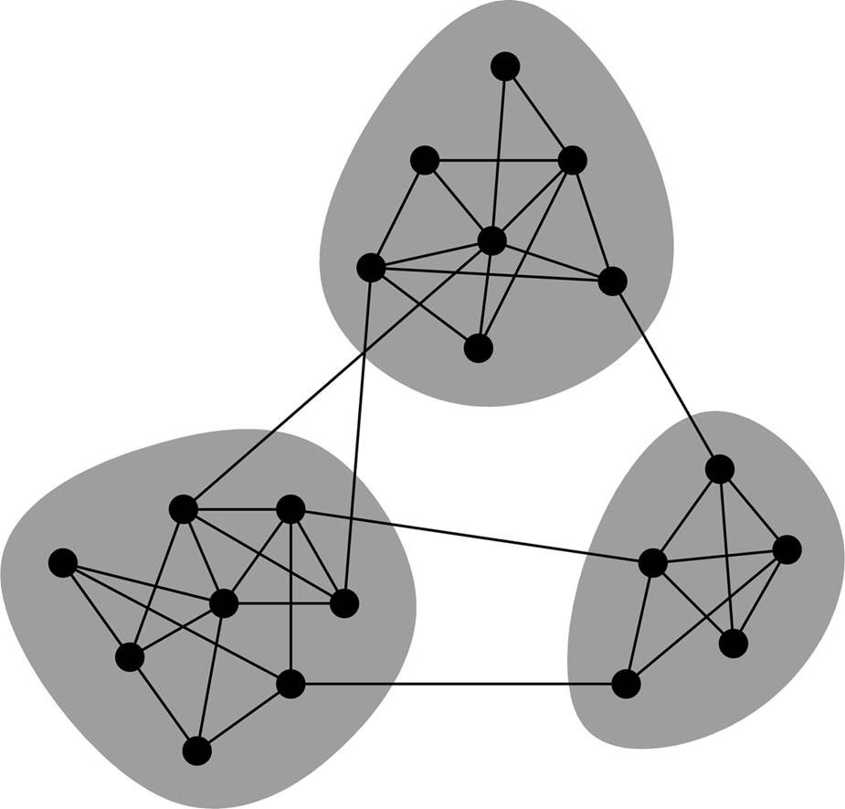
Network based
[Raad et al., 2018, UR]
C1
C2
C3
Considers the identity network build from the explicit identity network of sameAs links: removing of symmetric and reflexive links.
Uses of Louvain community detection algorithm to detect subgraphs in the identity network that are highly connected.
Defines a ranking score for each (intra-community and inter-community) identity link based on the density of the community.

Slide 55
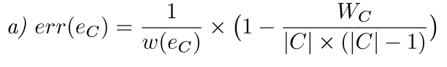
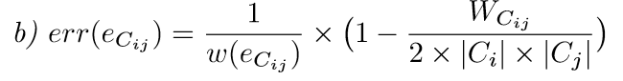
Network based
[Raad et al., 2018, under review]
Ranking of identity links
intra-community erroneousness degree
inter-community erroneousness degree
0
Error degree
1
Correct link
Erroneous link

Slide 56
Network based
[Raad et al., 2018, under review]
Dataset
LOD-a-lot dataset [Fernandez et al. 2017]: a compressed data file of 28B triples from LOD 2015 crawl
An explicit identity network of 558.9M edges (links) and 179M nodes (resources)
Identity network of 331M edges and 179M nodes: after removing symmetric and reflexive links.

Slide 57
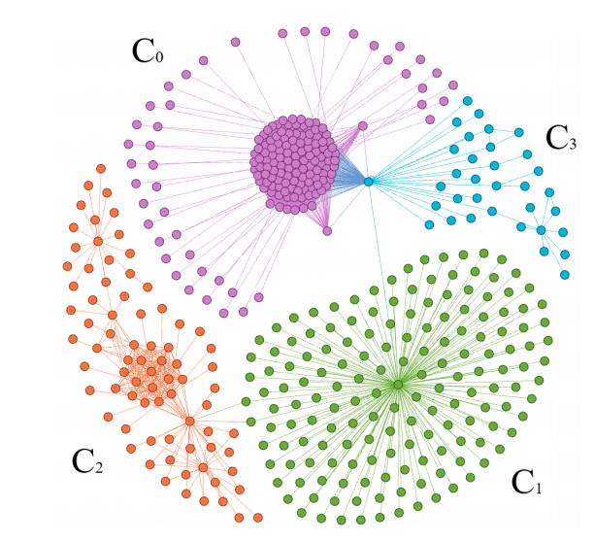
Network based
[Raad et al., 2018, under review]
Barack Obama’s Equality Set
DBpedia IRIs referring to the person Obama, his senator career
DBpedia IRIs referring to the person Obama in different languages
IRIs referring to the presidency and the Obama administration
DBpedia IRIs referring to the person Obama in different functions

Slide 58
Network based
[Raad et al., 2018, under review]
Barack Obama’s Equality Set
Low err(e) for the links of this community
Only these two links have err(e)= 1
Most of the links have err (e) = 0.9
Notes:
Communauté C1 problème dû à la faible densité du graphe.
Les seuls liens externes à C2 sont bien erronés.

Slide 59
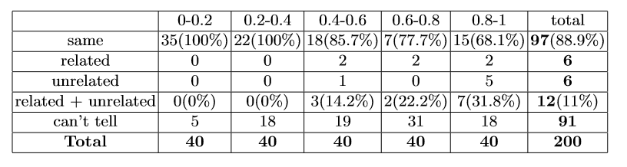
Network based
[Raad et al., 2018, under review]
Precision on a randomly chosen set identity links from LOD
Scales up to a graph of 28.3 billion triples: 12 hours
Validates correct owl:sameAs links
100% of owl:sameAs with an erroneousness degree <0.4 are correct
Can invalidate a large set of owl: sameAs links on the LOD:
1.26M owl:sameAs have an erroneousness degree in [0.99, 1]

Slide 60
Erroneous link detection: summary
Positive points
Different approaches relaying on different kinds of information (constraints, axioms, content and network)
Good scalability of the approaches: up to 28.3 Billion triples
Evaluations on real data on the LOD

Slide 61
Erroneous link detection: summary
Positive points
Different approaches relaying on different kinds of information (constraints, axioms, content and network)
Good scalability of the approaches: up to 28.3 Billion triples
Evaluations on real data on the LOD
Limitations
Qualitative evaluation often missing or conducted on only insignificant number of links (max= 200 avec 331 thousands)
Some assumptions can be assumed on only few datasets on the LOD: UNA and provenance information.
Ontology axioms are not always available: how to ensure their validity in every dataset. Is the LocatedIn is functional for every museum?
Difference relationships are rarely available: useful for inconsistency checking

Slide 62
Erroneous link detection: summary
“Due to the subjectivity of near-identity and similarity, we suggest that additional properties be used to describe the exact nature of the relationship”
‘‘common metrics such as centrality, clustering, and degree are insuﬃcient for detecting quality … Description Richness and Open SameAs Chain metrics look more promising, especially at detecting good and bad links, respectively, they report too many false positives for reference sets’’
‘‘Data linking algorithms (LIMES, SILK and DBpedia Extraction Framework) have a better consistency index than repositories such as sameas.org (13%) ’’
[Gueret et al., 2012 ]
[Valdestilhas et al., 2017]
[de Melo 2013]
➔
➔
➔
Need for hybrid approaches
Need for more controlled
link publication protocols
Need for alternate links
Notes:
Computing an optimal cut is NP-Hard.

Slide 63
2. Use of alternate links

Slide 64
2. Use of alternate links
Use of weaker alternative links to express relatedness between resources/concepts.
UMBEL¹ vocabulary introduces umbel:isLike “to assert an associative link between similar individuals who may or may not be identical, but are believed to be so”
Vocab.org² introduces similarTo to be used when having two things that are not the owl:sameAs
[de Melo, 2013 ] introduces lvont:nearlySameAs and lvont:somewhatSameAs, two predicates for expressing near-identity in the Lexvo.org³
Use of domain-specific identity relations:
ex:sameBook to express identity between two books
¹ http://umbel.org
² http://vocab.org
³ http://lexvo.org
Notes:
https://pridiyawulan.blogspot.fr/2015/01/clark-kent-atau-superman-pilih-yang-mana.html
wouterbeek.github.io

Slide 65
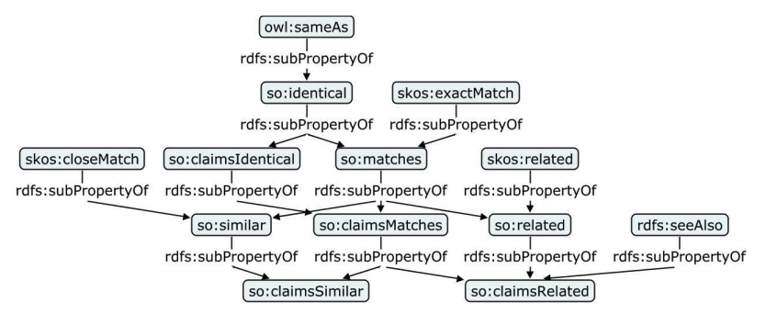
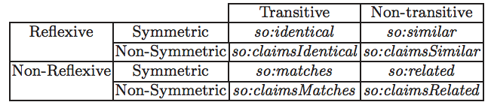
2. Use of alternate links
[Halpin et al., 2010] proposed a similarity ontology (SO) in which they hierarchically represent 13 different predicates including 8 new ones.
The similarity ontology (SO)
Reflexivity, Symmetry and Transitivity properties for the 8 new predicates.
Notes:
https://pridiyawulan.blogspot.fr/2015/01/clark-kent-atau-superman-pilih-yang-mana.html
wouterbeek.github.io

Slide 66
3. contextual identity links

Slide 67
3. contextual identity links
Weaker kinds of identity can be expressed by considering a subset of properties with respect to which two resources can be considered to be the same.
Identity is context-dependent [Geach, 1967]
allowing two medicines to be considered the same in terms of their chemical substance, but different in terms of their price (e.g., because they are produced by different companies).
Notes:
https://pridiyawulan.blogspot.fr/2015/01/clark-kent-atau-superman-pilih-yang-mana.html
wouterbeek.github.io

Slide 68
3. contextual identity links
[Beek et al., 2016]
Propose an approach that allows the characterization of the context in which an identity link is valid
A context is a subset of properties for which two individuals must have the same values
Contextual identity link preserves equivalence relation, w.r.t. a subset of the properties
Notes:
https://pridiyawulan.blogspot.fr/2015/01/clark-kent-atau-superman-pilih-yang-mana.html
wouterbeek.github.io

Slide 69
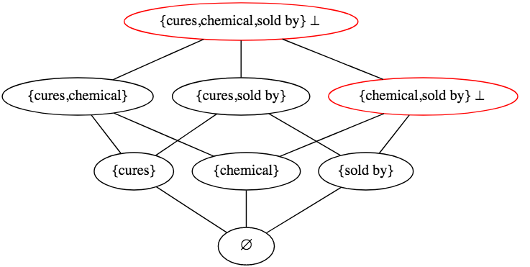
3. contextual identity links
[Beek et al., 2016]
All the possible subsets of properties organized in a lattice using the set inclusion relation.
Notes:
https://pridiyawulan.blogspot.fr/2015/01/clark-kent-atau-superman-pilih-yang-mana.html
wouterbeek.github.io

Slide 70
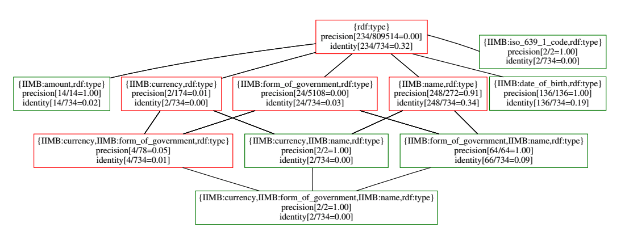
3. contextual identity links
[Beek et al., 2016]
Evaluation on a dataset in the instance matching track of the OAEI2012 : a variant of the IIMB datasets.
The obtained identity subrelations
Notes:
https://pridiyawulan.blogspot.fr/2015/01/clark-kent-atau-superman-pilih-yang-mana.html
wouterbeek.github.io

Slide 71
3. contextual identity links
[Raad et al., 2017]
New predicate :identiConTo for expressing contextual identity relation
An algorithm to for automatic detection of the most speciﬁc contexts in which two instances (resources) are identical
the detection process can further be guided by a set of semantic constraints that are provided by domain experts.
Contexts are deﬁned as a sub-ontology of the domain ontology
All the possible contexts are organized in a lattice using an order relation.
Notes:
https://pridiyawulan.blogspot.fr/2015/01/clark-kent-atau-superman-pilih-yang-mana.html
wouterbeek.github.io

Slide 72
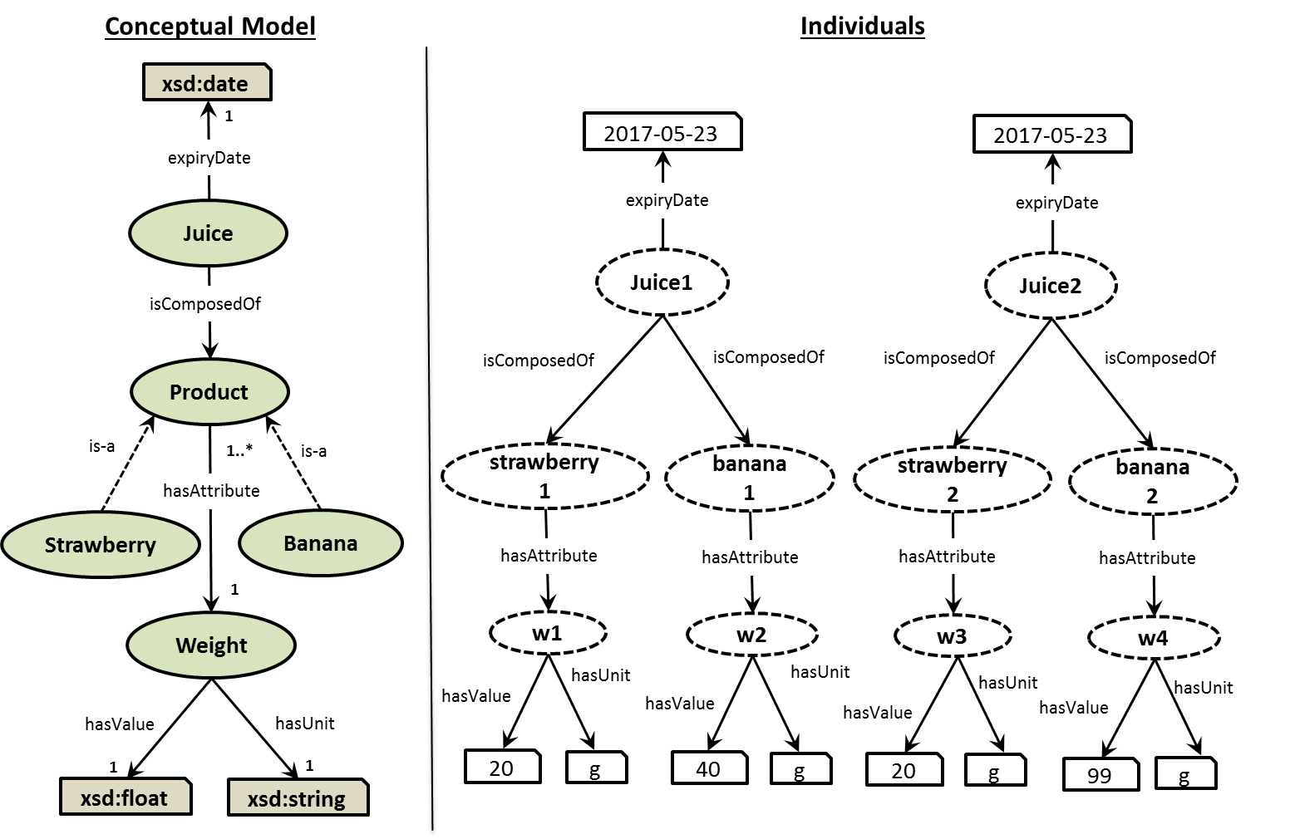
3. contextual identity links
[Raad et al., 2017]

Slide 73
3. contextual identity links
[Raad et al., 2017]
Contexts are deﬁned as a sub-ontology of the domain ontology
Contextual Identity Link Example
Π_{a}(Juice) = { (Juice, {rdf:Type, expiryDate}, {isComposedOf}),
(Banana, {rdf:Type}, {isComposedOf ⁻¹}), (Strawberry, {rdf:Type}, {hasAttribute, isComposedOf ⁻¹}),
(Weight, {rdf:Type, hasValue, hasUnit}, {hasAttribute⁻¹}) }
identiConTo_{<Πa(Juice)>}(juice1, juice2)

Slide 74
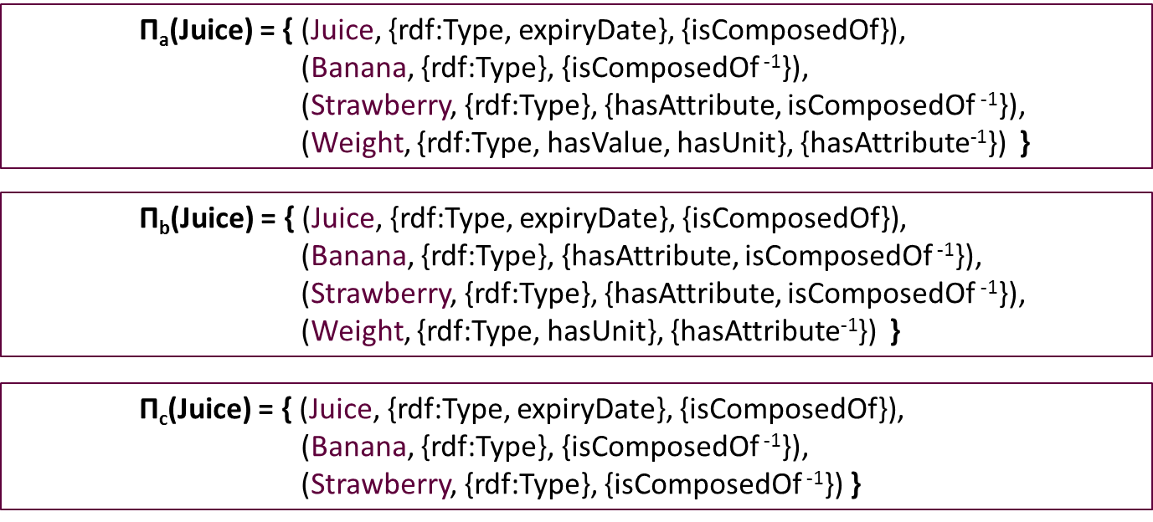
3. contextual identity links
[Raad et al., 2017]

Slide 75
3. contextual identity links
[Raad et al., 2017]
The possible contexts are organized in a lattice using an order relation.
…
Π_{c}(Juice)
Π_{a}(Juice)
Π_{b}(Juice)
…
Π_{a}(Juice) ≤ Π_{c}(Juice)
Π_{b}(Juice) ≤ Π_{c}(Juice)
each local context in Π_{c}(Juice) is less specific or equal to its corresponding local context in Π_{a}(Juice)

Slide 76
3. contextual identity links
[Raad et al., 2017]
It automatically detects and adds these contextual identity links in the knowledge graph
Knowledge
Graph
Source
Class
Paired
Properties
Unwanted
Properties
Necessary
Properties
DECIDE
DEtection of Contextual IDEntity
For each pair of instances (i₁, i₂) of the source class
set of the most specific global contexts in which (i₁, i₂) are identical

Slide 77



3. contextual identity links
[Raad et al., 2017]
Transformation of Micro-organisms
Digestion Process
- Classes: ≈ 4 700
- Individuals: ≈ 415 000
- Statements: ≈ 1 700 000
- Classes : ≈ 5 000
- Individuals: ≈ 42 000
- Statements : ≈ 237 000
RDF
RDF
CellExtraDry
Carredas

Slide 78
3. contextual identity links
[Raad et al., 2017]
Irrelevant properties
up = (observation, observes, *)
CellExtraDry + Carredas
DECIDE
DEtection of Contextual IDEntity
950 classes
1,5 millions triplets
284 processus de transformations
 | Experiment 1 | Experiment 2
 | Mixture | Step
# Instances | 1,187 | 581
# Possible pairs | 703,891 | 168,490
# Distinct Global Contexts | 2 232 | 718
# Contextual identity links | 1, 279,376 | 348,017
# Contextual identity links per pair | 1.81 | 2.06

Slide 79
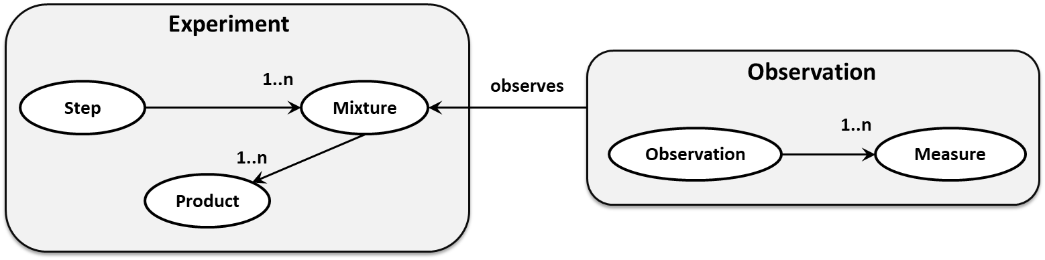
3. contextual identity links
[Raad et al., 2017]
Detect for each context GC_{i}, the measures m_{i} where
identiConTo_{<GCi>}(i₁, i₂) ∩ observes(i₁, m₁) → observes(i₂, m₂)
with m₁ ≃ m₂
identiConTo_{<GCi>}(i1, i2) → same(m_{i})

Slide 80
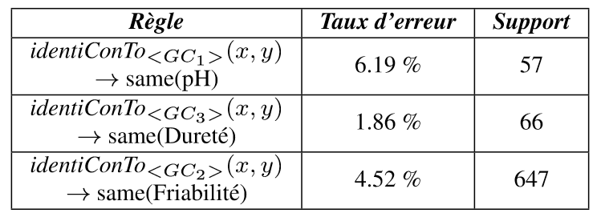
3. contextual identity links
[Raad et al., 2017]
Detection of 38 844 rules
The domain experts has evaluated the plausibility of the best 20 rules
(in termes of error rate and support)
Notes:
Règles entre "peu probale et pourquoi pas” = connaisance nouvelles pour les experts.
Calcul du taux d’erreur : calcul de la distance entre la valeur prédite et la valeur min et max dans les données.
Pour la distance on a utilisé la mesure de Chen et Chen pour les ensembles flous.

Slide 81
3. contextual identity links
[Raad et al., 2017]
Detection of 38 844 rules
The domain experts has evaluated the plausibility of the best 20 rules
(in termes of error rate and support)
3
5
4
5
3
plausibility
Impossible
Not very
probable
Can’t tell
Why not
Plausible
The error rate decreases of 12% when a global context is replaced by a more specific global context
Notes:
Règles entre "peu probale et pourquoi pas” = connaisance nouvelles pour les experts.
Calcul du taux d’erreur : calcul de la distance entre la valeur prédite et la valeur min et max dans les données.
Pour la distance on a utilisé la mesure de Chen et Chen pour les ensembles flous.

Slide 82
Link Validation: summary
Different kinds of identity relationship
b1
b2

Slide 83
Link Validation: summary
Different kinds of identity relationship
owl:sameAs
Genuine identity
lvont:somewhatSameAs
Near/weak identity
b1
b2

Slide 84
Link Validation: summary
Different kinds of identity relationship
owl:sameAs
Genuine identity
lvont:somewhatSameAs
Near/weak identity
b1
b2
:sameBook
:sameExpression
Subjective identity
:sameArtWork
:dentiConTo_{<Πa>}
Contextual identity

Slide 85
Link Validation: summary
Different kinds of identity relationship
Need of hybrid methods
owl:sameAs
Network Topology
lvont:somewhatSameAs
Source Reliability
b1
b2
:sameBook
Link Content
:sameExpression
:sameArtWork
Ontology Axioms
:dentiConTo_{<Πa>}

Slide 86
Link Validation: summary
Different kinds of identity relationship
Need of hybrid methods
Link quality assessment is not a matter of one unique dimension
owl:sameAs
Link Validity:
Inconsistent equivalent classes, Invalid links,
Contextual links
Network Topology
lvont:somewhatSameAs
Source Reliability
b1
b2
Link Properties:
Transitivity, symmetry, …
:sameBook
Link Content
:sameExpression
Link added-value:
Information gain, reachability, …
:sameArtWork
Ontology Axioms
:dentiConTo_{<Πa>}
Link meta-data:
availability, evolution

Slide 87
Link Validation: summary
What is about the distinctness relation?
Different kinds of identity relationship
Need of hybrid methods
Link quality assessment is not a matter of one unique dimension
owl:sameAs
Link Validity:
Inconsistent equivalent classes, Invalid links,
Contextual links
Network Topology
lvont:somewhatSameAs
Source Reliability
b1
b2
Link Properties:
Transitivity, symmetry, …
:sameBook
Link Content
:sameExpression
Link added-value:
Information gain, reachability, …
:sameArtWork
Ontology Axioms
:dentiConTo_{<Πa>}
Link meta-data:
availability, evolution

Slide 88
References (1)
[Beek et al., 2016 ] A contextualised semantics for owl: sameas.
W. Beek, S. Schlobach, and F. van Harmelen. In ESWC 2016
[CudreMauroux et al., 2009 ] idmesh: graph-based disambiguation of linked data.
P. CudreMauroux, P. Haghani, M. Jost, K. Aberer, and H. De Meer. In WWW 2009.
[de Melo, 2013] Not quite the same: Identity constraints for the web of linked data.
G. de Melo. In AAAI 2013.
[Geach, 1967 ] Identity. P. Geach. Review of Metaphysics, 21:3–12, 1967.
[Guéret et al. 2012] Assessing linked data mappings using network measures.
C. Guéret, P. Groth, C. Stadler, and J. Lehmann. In ESWC 2012
[Halpin et al., 2010] When owl:sameAs isn’t the same: An analysis of identity in Linked Data.
H. Halpin, P. J. Hayes, J. P. McCusker, D. L. McGuinness, and H. S. Thompson. In ISWC 2010.
[Hogan et al., 2012] Scalable and distributed methods for entity matching, consolidation and disambiguation over linked data corpora.
A. Hogan, A. Zimmermann, J. Umbrich, A. Polleres, and S. Decker. In JWS 2012.

Slide 89
References (2)
[Jaffri et al., 2008 ] URI disambiguation in the context of linked data.
A. Jaffri, H. Glaser, and I. Millard. In LDOW@WWW 2008.
[Paulheim, 2014] Identifying wrong links between datasets by multi-dimensional outlier detection.
H. Paulheim. In WoDOOM 2014.
[Papaleo et al., 2014] Logical detection of invalid sameas statements in rdf data.
L. Papaleo, N. Pernelle, F. Saïs, and C. Dumont. In EKAW 2014.
[Raad et al., 2017] Detection of contextual identity links in a knowledge base.
J. Raad, N. Pernelle, and F. Saïs. In K-CAP 2017.
[Raad et al., 2018 under review ] Detecting Erroneous Identity Links on the Web using Network Metrics. J. Raad, W. Beek, F. van Harmelen, N. Pernelle and F. Saïs. Submitted to ISWC 2018
[Valdestilhas et al., 2017 ] Cedal: time-efﬁcient detection of erroneous links in large-scale link repositories. A. Valdestilhas, T. Soru, and A.-C. N. Ngomo. In WI 2017.

